Slide 1
Stock daily return VS DowJ
By Yang Xiao

Slide 2
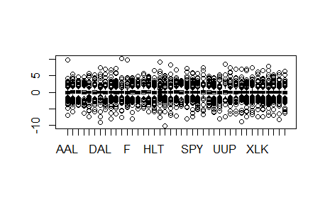
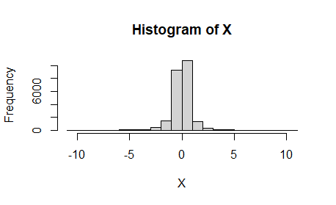
1.Nature and shape of data.
Datasets has 41 variables consisting of 17 ETFs (2 stock index ETFs – SPY and DIA, 10 sector ETFs – XLK, XLE, XLB, XLI, XLY, XLP, XLF, XLV, XLU and IYR in sectors like Information Technology and Financial, etc., and 5 non-equity ETFs – TLT for treasury, USO for oil, GLD for gold, UUP for currency and HYG for bond) and 24 equities (AAPL, T, FB, XOM, DD, CAT, AMZN, HLT, WMT, JPM, CVS, ED, CBRE,etc in 11 sectors, respectively, such as Energy, Materials and Industrials, etc.) from 01/02/2018 to 04/30/2020 total 586 records. Response variable is DOW J index. From the boxplot and histogram, all data are concentrated on around 0.

Slide 3
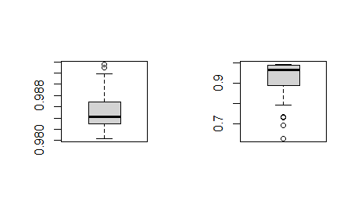
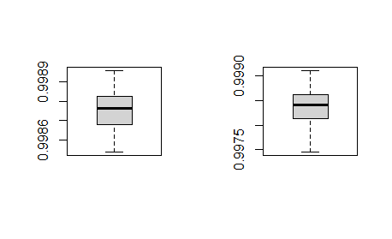
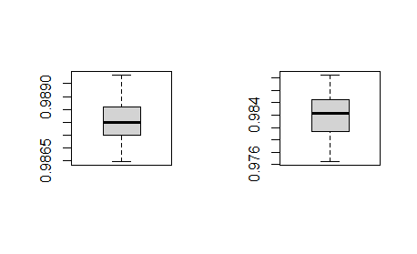
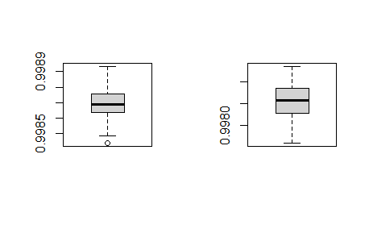
2. side-by-side boxplot
Random forest: training vs testing
Elastic-net :training vs testing
Ridge regression: training vs testing
Lasso regression: training vs testing

Slide 4
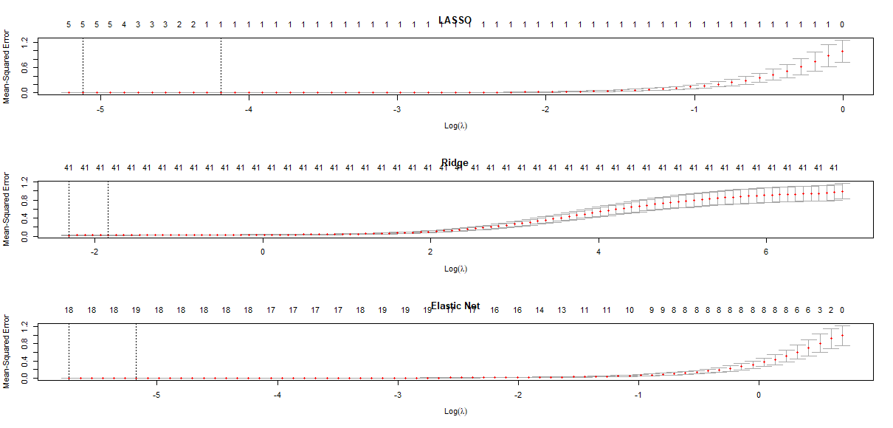
3. 10-fold CV curves

Slide 5
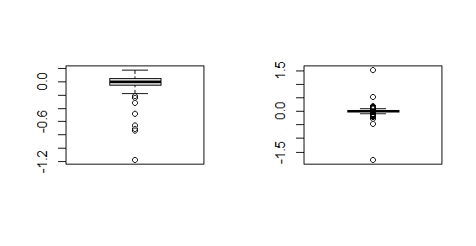
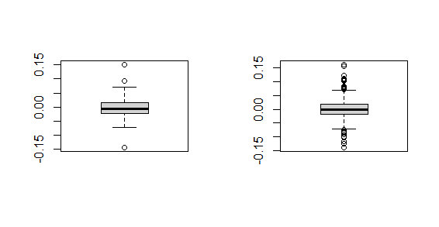
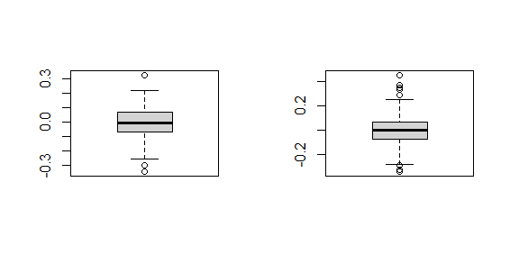
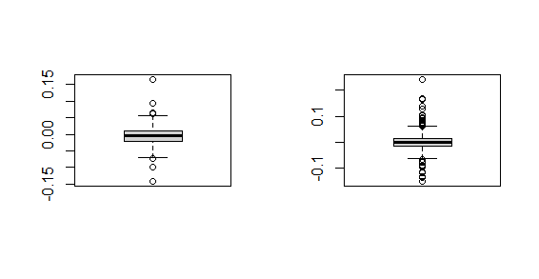
4. side-by-side residual boxplot(I will comment these in video)
Random forest: testing vs training
Elastic-net :testing vs training
Ridge regression: testing vs training
Lasso regression: testing vs training

Slide 6
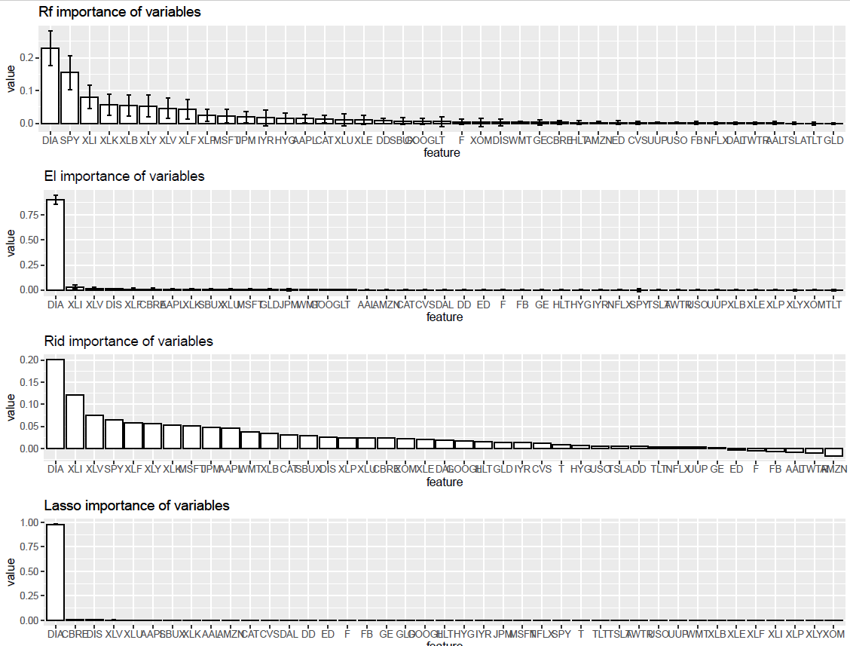
5.Barplots with bootstrap (I will do comment on this page in video)

Slide 7
6.Time and summary
Ridge regression running time:15.796660
Lasso regression running time:8.785736
El regression running time:11.161375
Random forest running time:169.072106
Summary:
For running time, RF consumes more time than the other three since my predictors have truly linear
relationship with response variable. Some main field stocks and DOWJ. Ridge needs more time than Lasso, since Ridge do norm2 as penalty and Lasso do norm1 as penalty , more or less , norm2 will occupy more CPU than norm1, the output is what I expected before running code.

